Slide 1
Gaussian Pyramid and Its Applications
Speaker: Po-Hung Wu

Slide 2
Outline
Introduction
Gaussian and Laplacian pyramid
Application
Salient region detection
Edge-aware image processing
Conclusion
Reference

Slide 3
Introduction
Why Gaussian?
Easy to implement!
A hierarchical way!

Slide 4
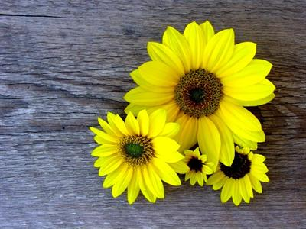
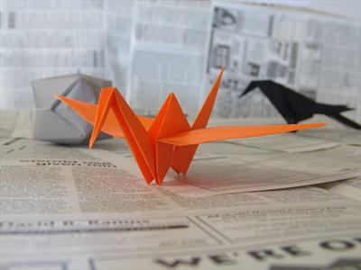
Introduction
What is salient object?
Everyone knows that …..

Slide 5
Introduction
What is edge-aware image processing?

Slide 6
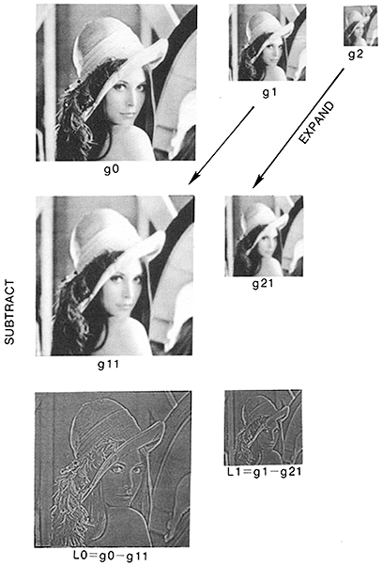
Gaussian and Laplacian pyramid
g0 : original image
gn : downsample [g(n-1)*G]
G : Gaussian filter
gn1 : interpolate [gn]
Ln = gn – gn1
gn is called Gaussian pyramid
Ln is called Laplasian pyramid
(Use DoG to approximate
Laplacian)

Slide 7
Gaussian and Laplacian pyramid
Synthesis
What’s app?
Compression ….Wavelet transform?

Slide 8
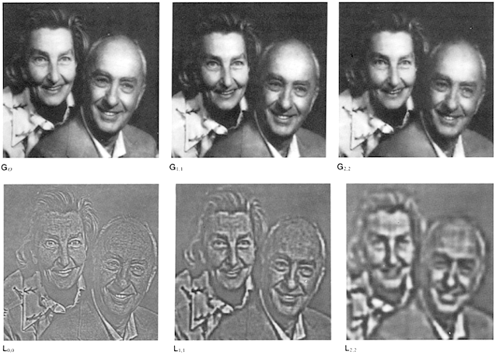
Gaussian and Laplacian pyramid
Hierarchical

Slide 9
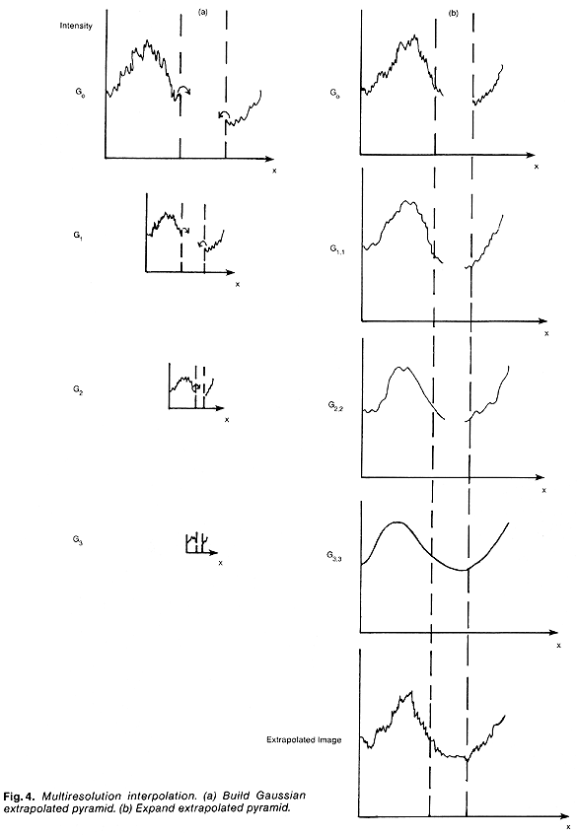
Application
Multiresolution
interpolation and
extrapolation:
Taylor series expansion

Slide 10
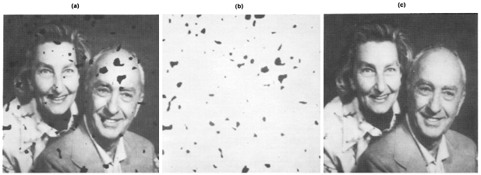
Application
Multiresolution interpolation and extrapolation

Slide 11
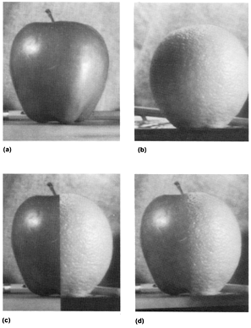
Application
Image merging

Slide 12
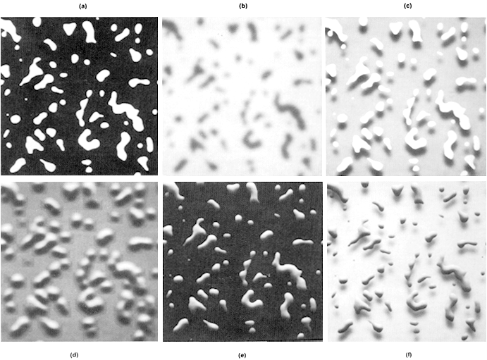
Application
Creating realistic looking images

Slide 13
App : Salient Region Detection
Goals
well boundary
uniformly highlighted salient region
computational efficiency

Slide 14
App : Salient Region Detection
Alg.
band-pass filter
Saliency map
Iu : mean pixel value
Iwhc : image pixel vector in the Gaussian blurred version

Slide 15
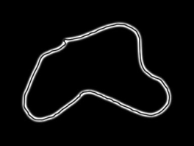
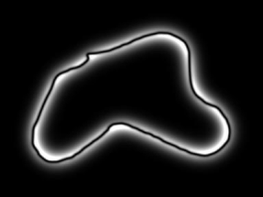
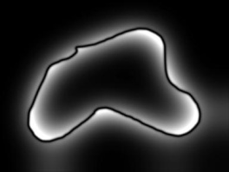
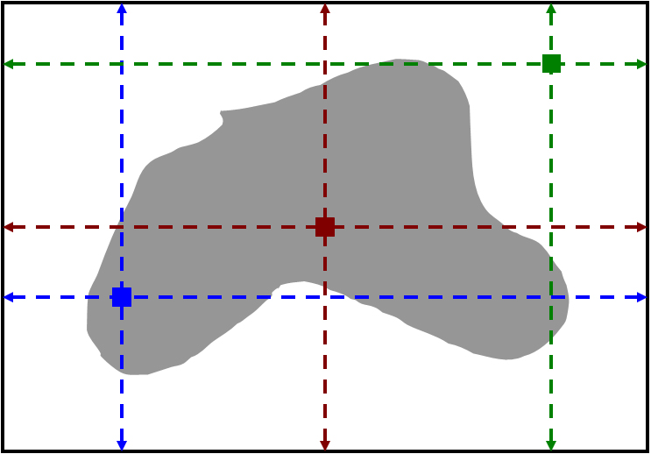
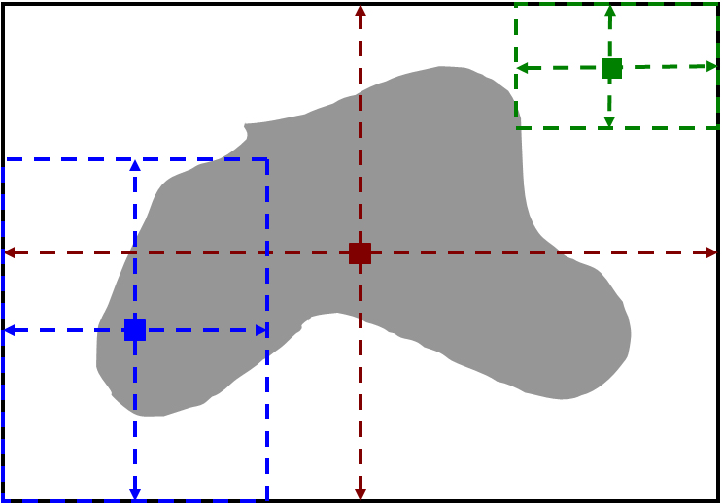
App : Salient Region Detection
Maximum symmetric surround for enhancement

Slide 16
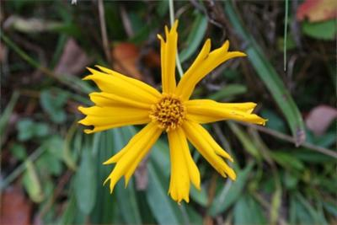
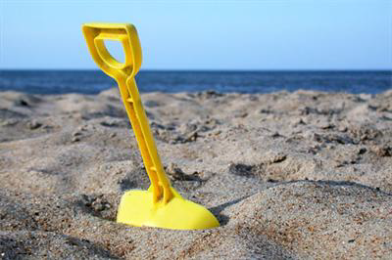
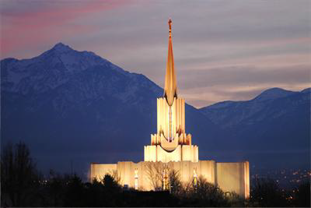
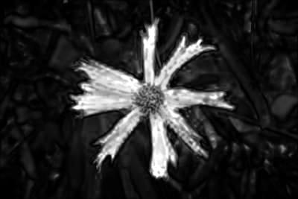
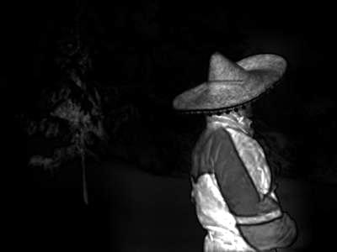
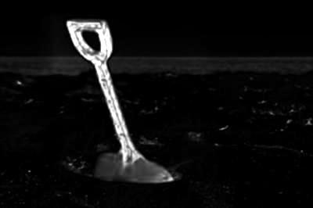
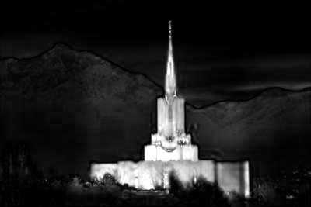
App : Salient Region Detection

Slide 17
App : Salient Region Detection
What’s drawbacks?
Object not in the middle
(Colorful background)
….???

Slide 18
App: edge-aware image processing
What’s edge-aware image processing?
The amplitude of main edges may be increased or reduced, but the edge transitions should not be smoother or sharper.

Slide 19
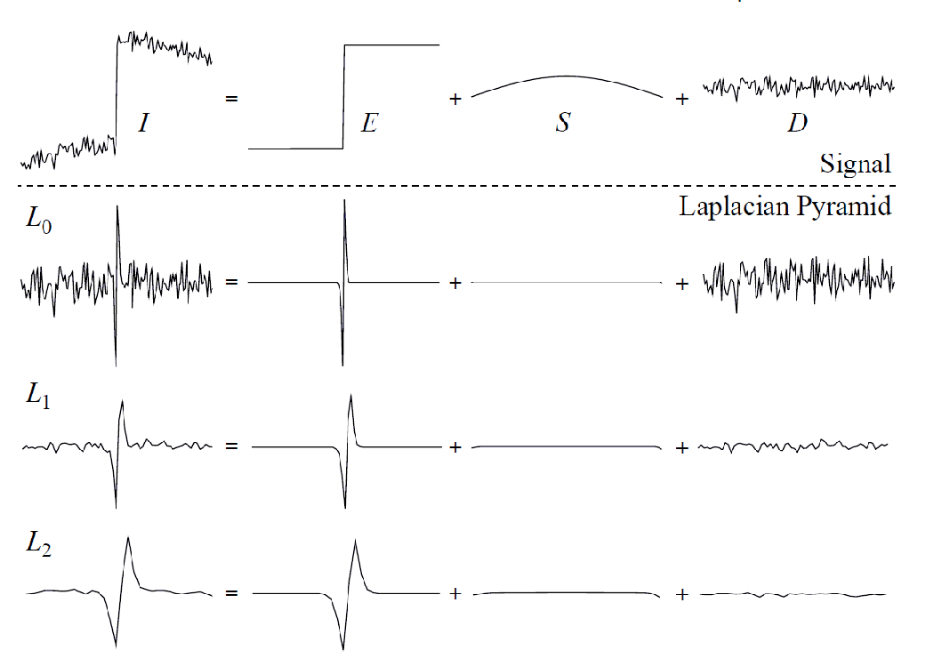
App: edge-aware image processing
Signal decomposition in Laplacian pyramid

Slide 20
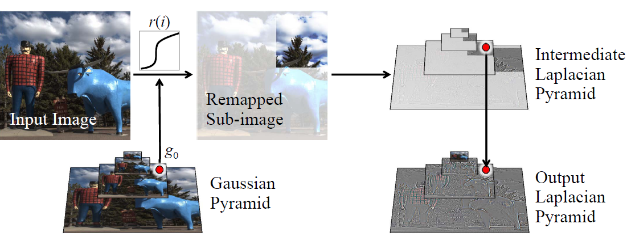
App: edge-aware image processing

Slide 21
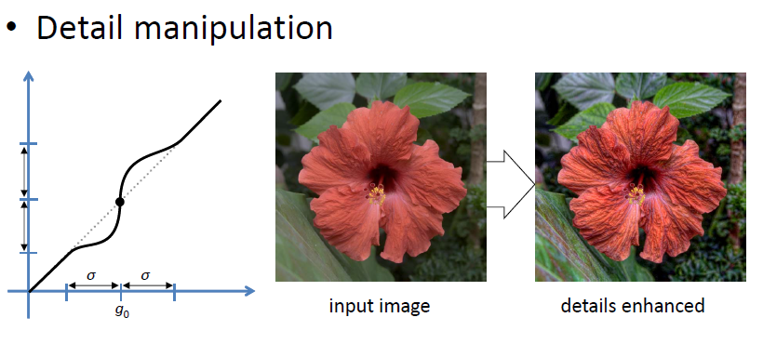
App: edge-aware image processing

Slide 22
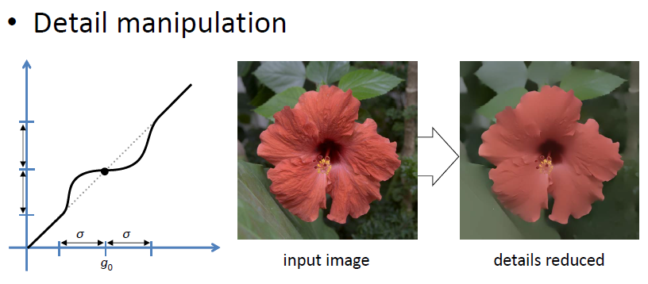
App: edge-aware image processing

Slide 23
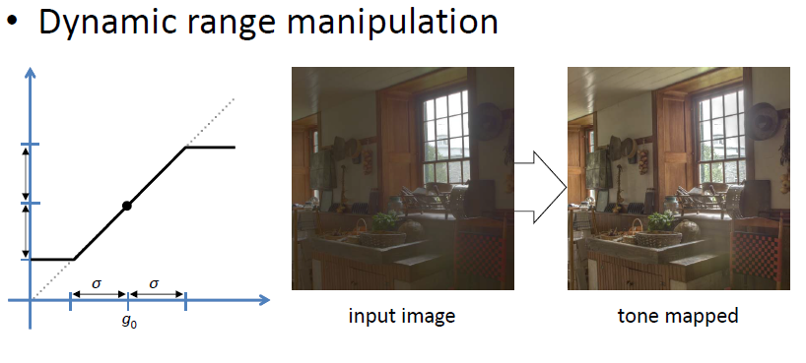
App: edge-aware image processing

Slide 24
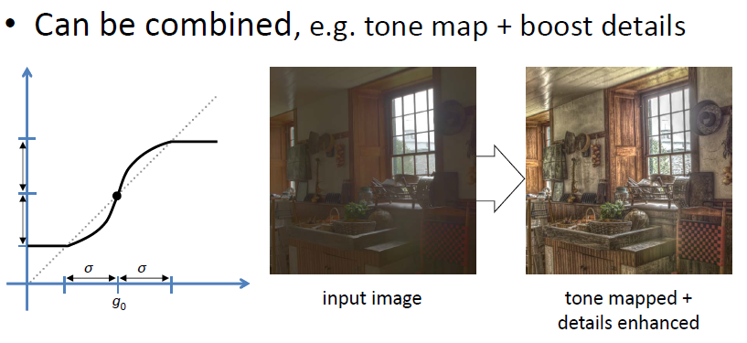
App: edge-aware image processing

Slide 25
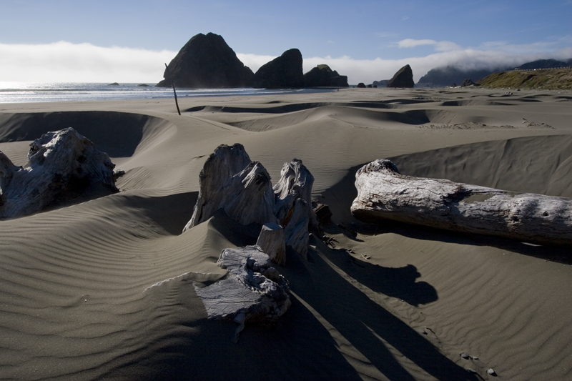
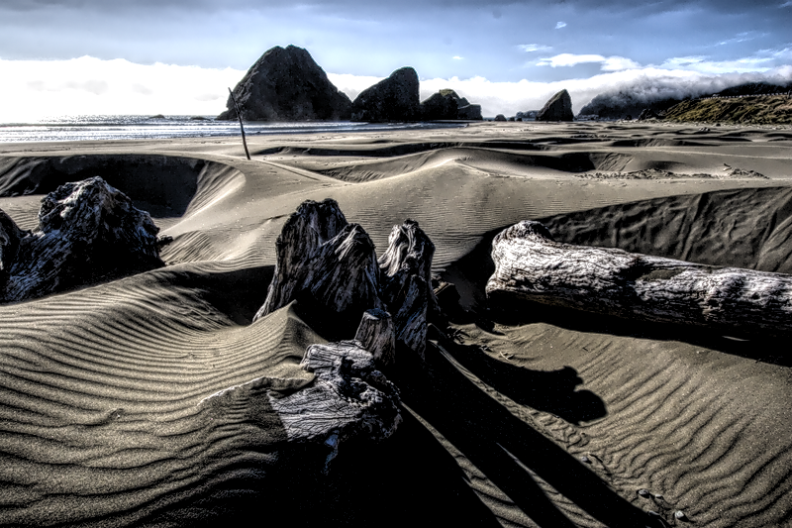
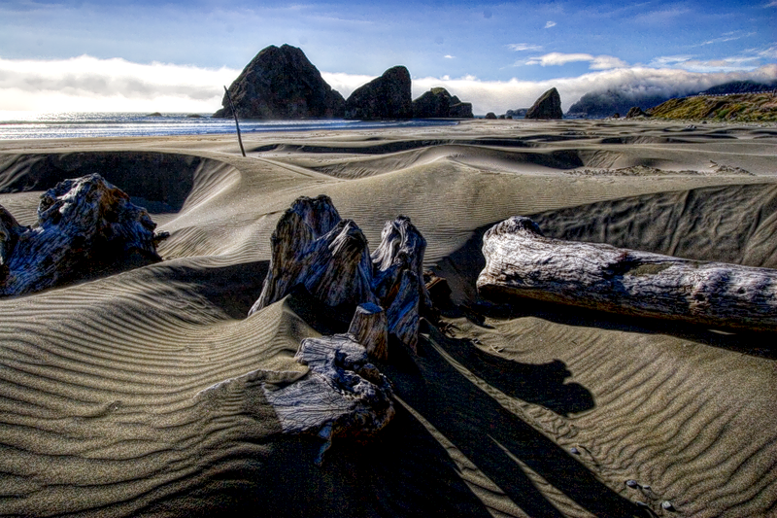
App: edge-aware image processing
More example
Input luminance channel RGB channel

Slide 26
Conclusion
Gaussian is powerful.
Laplacian pyramids good for edge‐aware editing
Image processing is cool.

Slide 27
Reference
[1] OGDEN, J. M., ADELSON, E. H., BERGEN, J. R., AND BURT, P. J. Pyramid-Based Computer Graphics. RCA Engineer 30 (1985), 4–15.
[2] PARIS, S., HASINOFF, S.W., AND KAUTZ, J. 2011. Local laplacian filters: Edge-aware image processing with a laplacian pyramid. ACM Trans. Graph..
[3] R. Achanta, S. Hemami, F. Estrada, and S. S¨usstrunk, “Frequency-tuned salient region detection,” IEEE International Conference on Computer Vision and Pattern Recognition, pp. 1597–1604, June 2009.
[4] R. Achanta and S. S¨usstrunk. Saliency detection using maximum symmetric surround. In Proc. of Int’l Conf. on Image Processing (ICIP), 2010.
[5] http://www.csie.ntu.edu.tw/~cyy/ (Pro. Yung-Yu Chuang)

Slide 28
Thank you for your attention!!!

